Slide 1
SQUADRA TECHNOLOGIES
security Removable Media Manager
secRMM

Slide 2
Security Removable Media Manager (“secRMM”)
secRMM is an Insider Threat Protection/Data Loss Prevention (“DLP”) Windows security software solution which controls and monitors removable “plug-and-play” storage.
Policies for ALL removable storage including mobile devices, USB, encrypted USB, CD/DVD/Blu-ray, SDCard, etc.
secRMM’s simple policies provide customers with the knowledge and control of who, what, when, where and how file copies are performed or attempted to be performed.

Slide 3
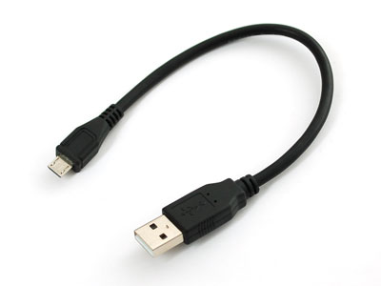
What problem does secRMM solve?
Difficult to monitor plug-and-play activity
secRMM provides detailed auditing of all writes to removable media
Difficult to protect sensitive data from leaving the domain/organization
Protect removable media write activity with simple but powerful policies/rules

Slide 4
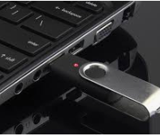
What problem does secRMM solve?
Regulatory Compliance
Network security concerns have increasingly driven regulatory initiatives across the globe (i.e. DOD NIST-SP 800-171)
Insider Threat Protection/Data Loss Prevention
“Cyber intrusions increased dramatically over the last decade, exposing sensitive personal and business information, disrupting critical operations, and imposing high costs on the economy.”- U.S. Department of Homeland Security
Organizations should implement a Defense-in-Depth layered strategy including technical defenses that monitor, log, analyze and report successful and attempted intrusion into their systems and networks.
secRMM’s policies and detailed auditing provides cost effective security and compliance safeguards across a vast array of market verticals.

Slide 5
Unrivaled Security Auditing
secRMM delivers unrivaled security auditing by logging the following items:
Successful file transfer
Failed (unauthorized) file transfer
UserID of end-user performing file transfer
ID of removable storage device (serial number, internal id, volume)
“Complete” source file (including drive/path). Also, file size and last modified date
Administrative changes (policy creation, modification, deletion)
Removable storage devices going on-line and off-line
HyperV/Azure, Vmware, Citrix support - logging removable storage events initiated within virtual machines
Contents of compressed (zip, rar, 7z) files listed out
Time and computer name

Slide 6
Policy Rules
secRMM uses Whitelist rules, then it Blacklists everything else
The following secRMM policy rules control the use of removable storage based on:
Directories (prohibit the transfer of files from specific directories)
User Ids
Device Serial Numbers
Device Internal IDs (VIDs and/or PIDs)
Programs used to perform file transfers
Device encryption mode (hardware, software)
Mobile Device Management policy (Microsoft Intune)
SmartCard (CAC), Finger print authorization, Azure Verifiable Credentials

Slide 7
Key Benefits
Provides security to prevent the mounting and data transfer to any removable media device including classic USB (thumb drive), Android, Apple, Windows, and Blackberry, CD/DVD, Blu-ray, SDCard.
Captures the complete path of the source file being copied onto any removable media device (i.e. knowledge of the exact file that has been written and where it came from).
Logs failed attempt and successful data transfers through USB providing the who, what, when, where and how of any attempted file transfer.
Policies for both computer and user groups (user policy over-rides computer)
Seamlessly works with hardware/software encryption technologies.
No back-end framework is required
Back-end framework integration with Microsoft Azure, System Center, Active Directory. Also generates SNMP, SYSLOG, EMAIL, Teams, Azure log events
Simple Deployment (standard Windows msi)

Slide 8
Key Benefits
Unloads when no removable media is mounted, OS loads on demand
100% Microsoft scriptable (for automation): Powershell, vbscript, CMD, .Net
Blocks programs/macros from running off removable storage
Invoke anti-virus scan on removable storage at mount time (MS Defender)
Works with cloud and on-premise virtualization - RDP
Includes utilities (SafeSync, SafeCopy) to manage mobile devices over USB. Installing (side-loading, not from app store) apps and copying files (classified/sensitive data, wi-fi too slow for large amounts of data)
Supports all Windows versions (including XP and x86/x64 hardware)
Excel Add-In for easy viewing and analysis
Monitor the administrator (including automation changes)

Slide 9
Key Benefits
Logs keystrokes on data transfers from the command line
Optional mobile app to further authenticate user before device can mount
Pre-written reports for System Center (SCCM and SCOM) or standalone SQL
Double logging into Windows Security Event Log
Utilize Windows event log archiving to never lose event data (convenient for backups). Also supports Windows event forwarding.
Developed and supported in the United States
Can be configured for “two man” approval mode (SafeCopy)
Compute and log hash code for files
Microsoft Azure/System Center/MISA partner

Slide 10
Current secRMM customers
Banking/Financial institutions in US and abroad
Legal
Medical/Hospital
Local/State government
DOD/Military
Defense Contractors (particularly SCIF envs)
Retail
Chemical
Manufacturing

Slide 11
Comprehensive Protection Stack
Reactive Techniques (Against Known Threats)
Proactive Techniques (Against Unknown Threats)
Application
Behavior Monitoring
Dynamic Cloud Updates
Data Execution Prevention
Address Space Layout Randomization
Windows Resource Protection
Microsoft Malware Protection Center
Dynamic Signature Service
File System
Anti-malware
Dynamic Translation and Emulation
Microsoft BitLocker™
Microsoft AppLocker™
Removable media/ Mobile devices
DLP/Insider Threat
Microsoft BitLocker™
Network
Vulnerability Shielding (Network Inspection System)
Windows Firewall Centralized Management
MS Defender
Windows OS
Notes:
SCEP builds on the security features already available on Windows 7 to provide a comprehensive protection from evolving threats.
The consistent high scores from third party testing are a result of multiple methods of protection and controls available in Forefront Endpoint Protection. We categorize protections in to 2 based on the threats: Reactive techniques or protection against known threats And the second category of proactive techniques or protections against unknown threats.
SCEP covers both of these categories across multiple layers of the system.
The enhanced protection starts with the core antimalware engine- there are many enhancements introduced in this engine that enable efficient scanning of the system without impacting productivity. It includes Advanced rootkit scanning and remediation against sophisticated threats. Other technologies that provide proactive protection include Behavior Monitor and Dynamic Translation or heuristics detection. With behavior monitoring, clients can get signature updates through the cloud with the dynamic signature service and get near real time protection updates against fast evolving threats.
SCEP also introduces a new feature called Network Vulnerability Shielding- this protects the clients against intrusions and exploits by inspecting network layer traffic.
With SCEP, admins will be also able to manage desktop firewall settings from the management console.
secRMM builds on the security features already available on Windows to provide a very powerful data leak protection solution for removable media and smart phones.

Slide 12
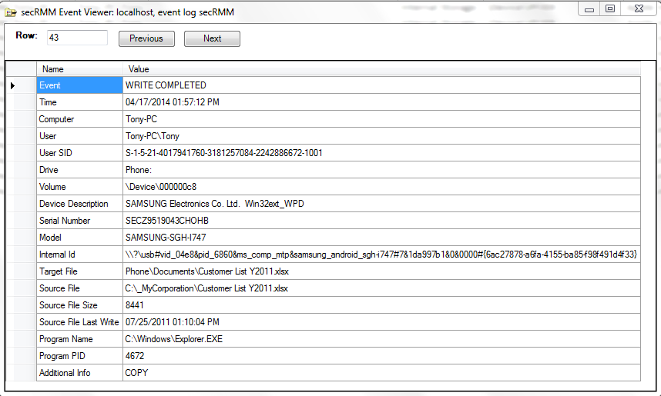
Write event - success

Slide 13
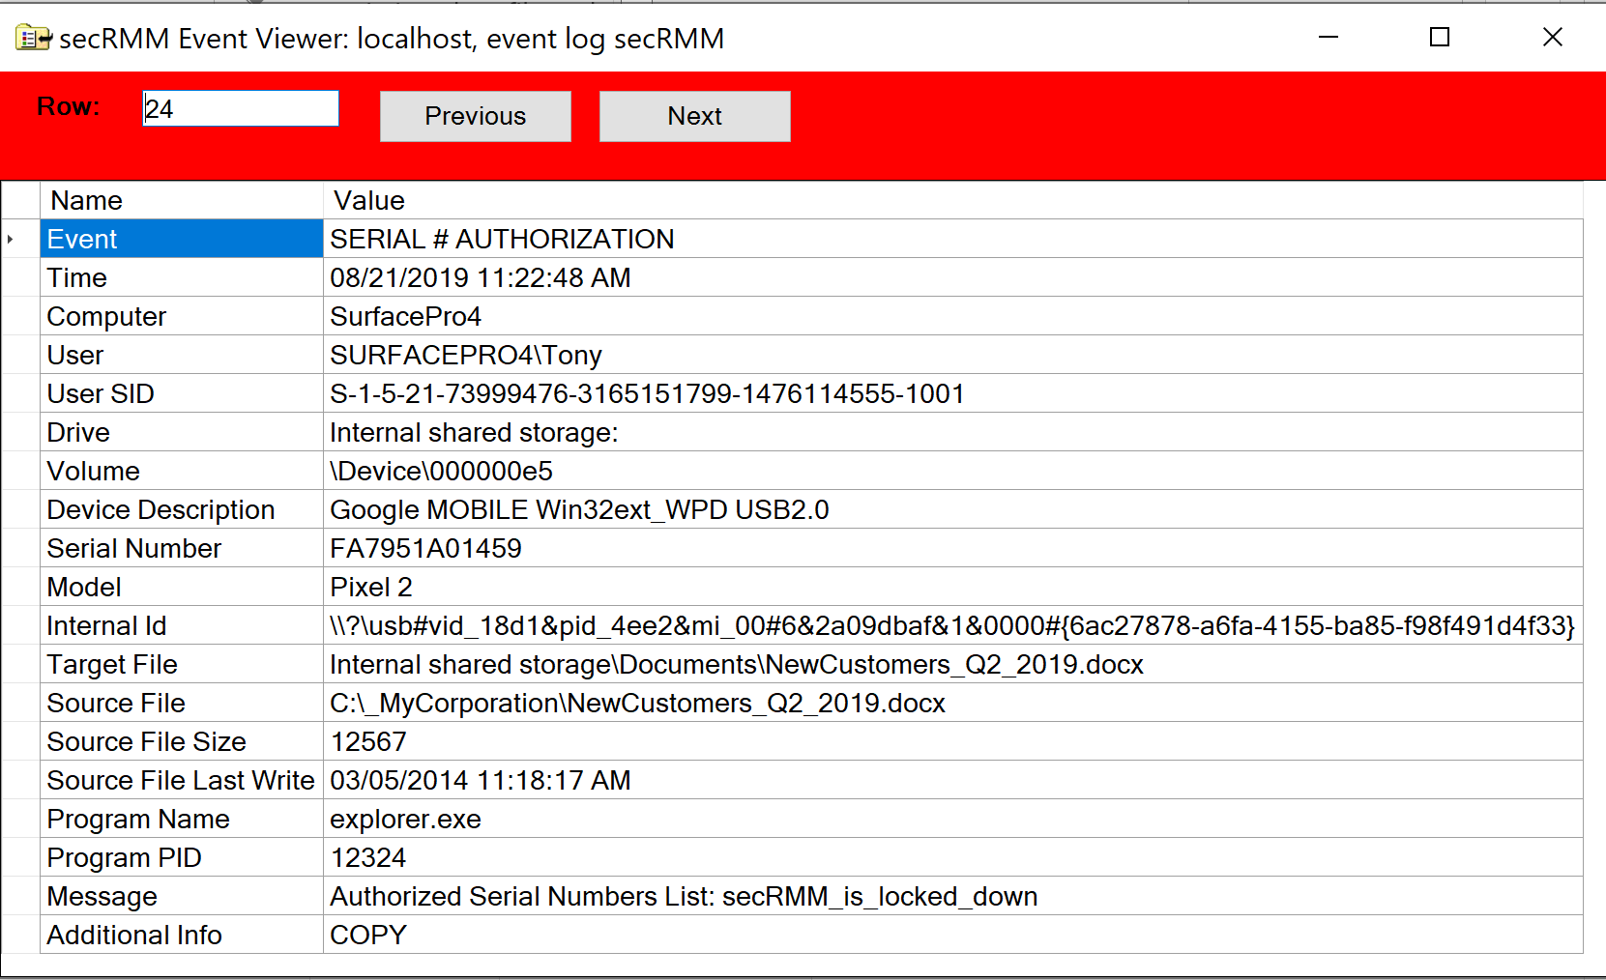
Write event - failed

Slide 14
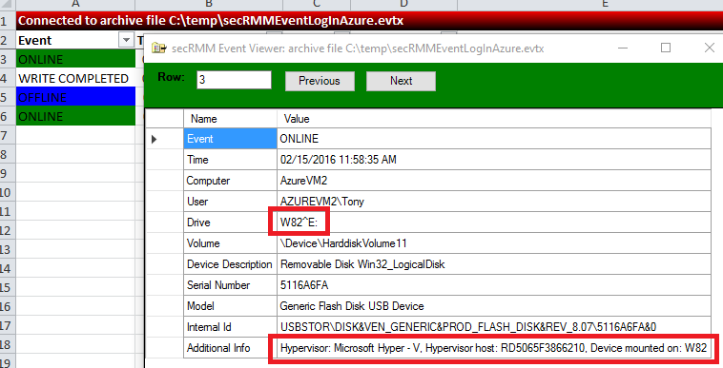
Azure/HyperV online event

Slide 15
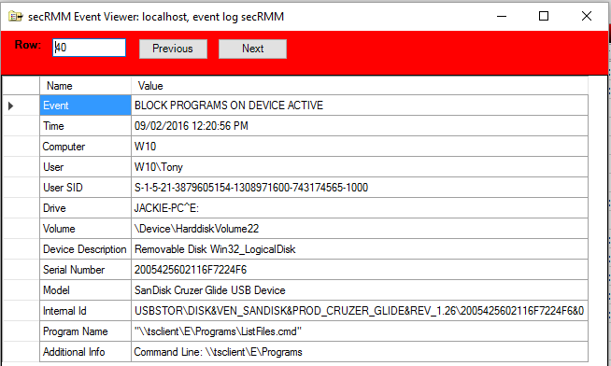
Block Programs (over RDP)

Slide 16
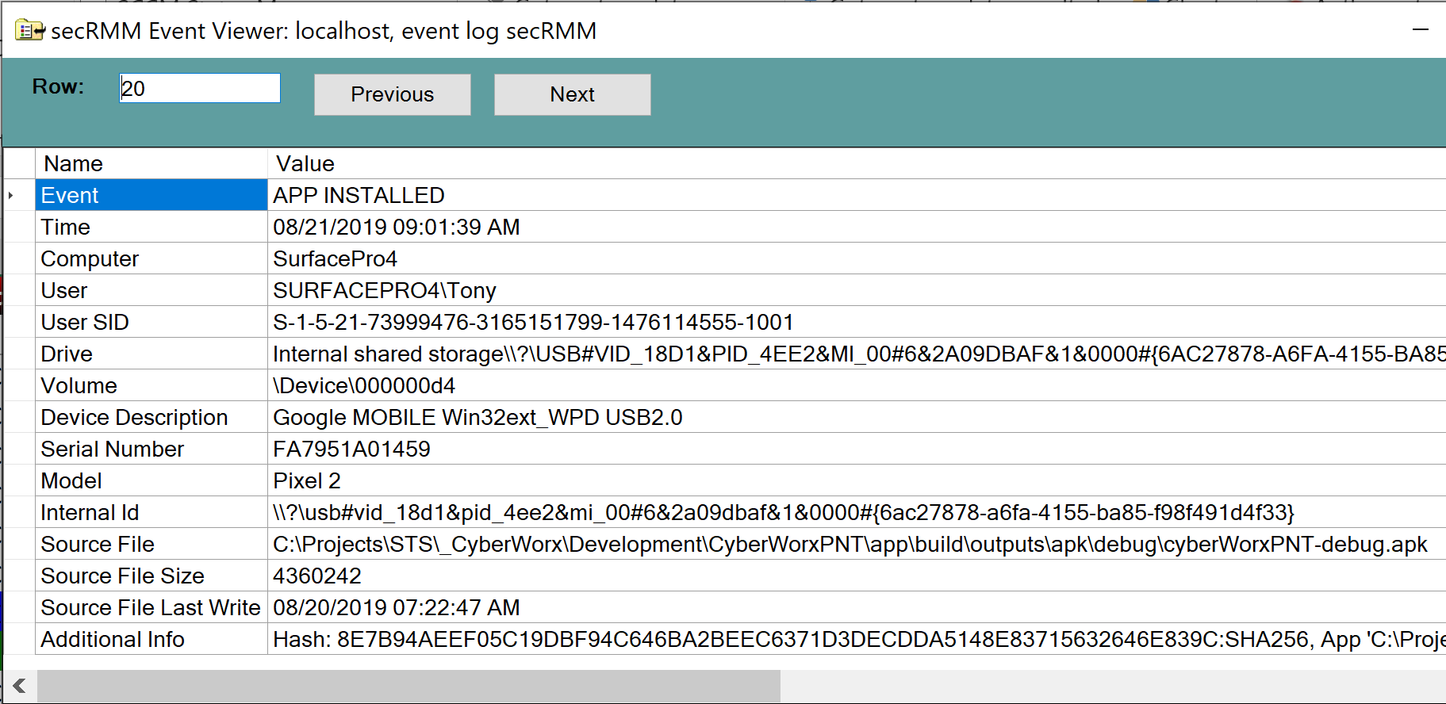
Android App install (side-loading)

Slide 17
secRMM future goals
Integrate into:
Air Force Standard Desktop Configuration (SDC)
Navy JSIM

Slide 18
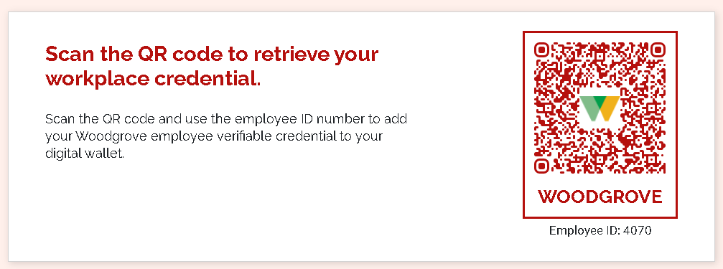
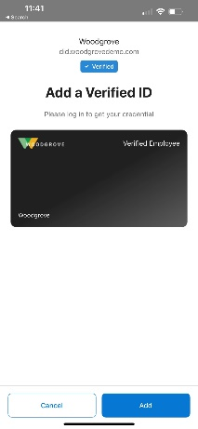
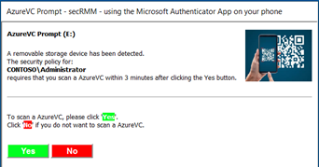
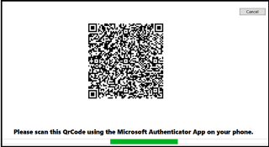
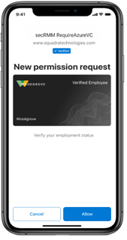
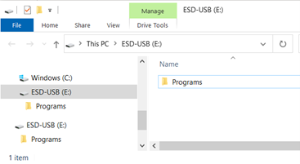
Employee Proofing for data exfiltration
Invitation
Employee is invited to get a Workplace credential (Verified ID for Employee) issued.
Issuance
WoodGrove issues a Verified ID credential for Employee
Start
Presentation
Employee presents Verified ID proof to SecRMM
Notes:
Trustworthy self-service enrollment and faster onboarding by digitally validating information with industry leading ID verification providers.

Slide 19
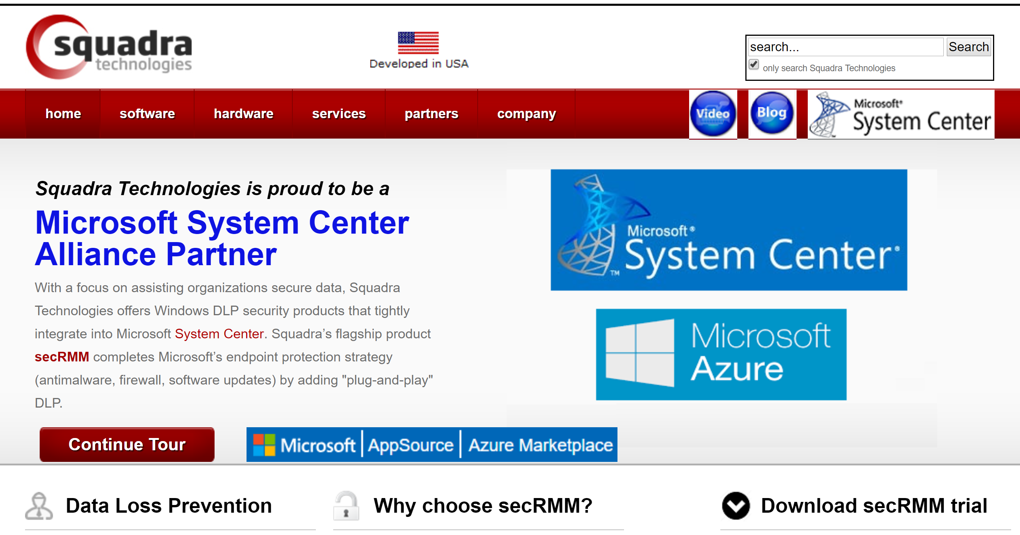
www.squadratechnologies.com
info@squadratechnologies.com

